Slide 1
Hypothesis Testing with One Sample

Slide 2
Introduction to Hypothesis Testing

Slide 3
Hypothesis Tests
A hypothesis test is a process that uses sample statistics to test a claim about the value of a population parameter.
If a manufacturer of rechargeable batteries claims that the batteries they produce are good for an average of at least 1,000 charges, a sample would be taken to test this claim.
A verbal statement, or claim, about a population parameter is called a statistical hypothesis.
To test the average of 1000 hours, a pair of hypotheses are stated – one that represents the claim and the other, its complement. When one of these hypotheses is false, the other must be true.

Slide 4
Stating a Hypothesis
“H subzero” or “H naught”
A null hypothesis H₀ is a statistical hypothesis that contains a statement of equality such as ≤, =, or ≥.
“H sub-a”
A alternative hypothesis H_{a} is the complement of the null hypothesis. It is a statement that must be true if H₀ is false and contains a statement of inequality such as >, ≠, or <.
To write the null and alternative hypotheses, translate the claim made about the population parameter from a verbal statement to a mathematical statement.

Slide 5
Stating a Hypothesis
Example:
Write the claim as a mathematical sentence. State the null and alternative hypotheses and identify which represents the claim.
A manufacturer claims that its rechargeable batteries have an average life of at least 1,000 charges.
μ ≥ 1000
H₀:
H_{a}:
μ ≥ 1000 (Claim)
Condition of equality
μ < 1000
Complement of the null hypothesis

Slide 6
Stating a Hypothesis
Example:
Write the claim as a mathematical sentence. State the null and alternative hypotheses and identify which represents the claim.
Statesville college claims that 94% of their graduates find employment within six months of graduation.
p = 0.94
H₀:
H_{a}:
p = 0.94 (Claim)
Condition of equality
p ≠ 0.94
Complement of the null hypothesis

Slide 7
Types of Errors
No matter which hypothesis represents the claim, always begin the hypothesis test assuming that the null hypothesis is true.
At the end of the test, one of two decisions will be made:
1. reject the null hypothesis, or
2. fail to reject the null hypothesis.
A type I error occurs if the null hypothesis is rejected when it is true.
A type II error occurs if the null hypothesis is not rejected when it is false.

Slide 8
Types of Errors
Actual Truth of H₀
Decision
H₀ is true
H₀ is false
Do not reject H₀
Correct Decision
Type II Error
Reject H₀
Type I Error
Correct Decision

Slide 9
Types of Errors
Example:
Statesville college claims that 94% of their graduates find employment within six months of graduation. What will a type I or type II error be?
H₀:
H_{a}:
p = 0.94 (Claim)
p ≠ 0.94
A type I error is rejecting the null when it is true.
The population proportion is actually 0.94, but is rejected. (We believe it is not 0.94.)
A type II error is failing to reject the null when it is false.
The population proportion is not 0.94, but is not rejected. (We believe it is 0.94.)

Slide 10
Level of Significance
In a hypothesis test, the level of significance is your maximum allowable probability of making a type I error. It is denoted by α, the lowercase Greek letter alpha.
The probability of making a type II error is denoted by β, the lowercase Greek letter beta.
Hypothesis tests are based on α.
By setting the level of significance at a small value, you are saying that you want the probability of rejecting a true null hypothesis to be small.
Commonly used levels of significance:
α = 0.10
α = 0.05
α = 0.01

Slide 11


Statistical Tests
After stating the null and alternative hypotheses and specifying the level of significance, a random sample is taken from the population and sample statistics are calculated.
The statistic that is compared with the parameter in the null hypothesis is called the test statistic.
Population parameter
Test statistic
Standardized test statistic
μ
z (n ≥ 30)
t (n < 30)
p
z
σ²
s²
X²

Slide 12
P-values
If the null hypothesis is true, a P-value (or probability value) of a hypothesis test is the probability of obtaining a sample statistic with a value as extreme or more extreme than the one determined from the sample data.
The P-value of a hypothesis test depends on the nature of the test.
There are three types of hypothesis tests – a left-, right-, or two-tailed test. The type of test depends on the region of the sampling distribution that favors a rejection of H₀. This region is indicated by the alternative hypothesis.

Slide 13

Left-tailed Test
1. If the alternative hypothesis contains the less-than inequality symbol (<), the hypothesis test is a left-tailed test.
H₀: μ ≥ k
H_{a}: μ < k
P is the area to the left of the test statistic.
z
-3
-2
-1
0
1
2
3
Test statistic

Slide 14
Right-tailed Test
2. If the alternative hypothesis contains the greater-than symbol (>), the hypothesis test is a right-tailed test.
H₀: μ ≤ k
H_{a}: μ > k
P is the area to the right of the test statistic.
z
-3
-2
-1
0
1
2
3
Test statistic

Slide 15

Two-tailed Test
3. If the alternative hypothesis contains the not-equal-to symbol (≠), the hypothesis test is a two-tailed test. In a two-tailed test, each tail has an area of P.
H₀: μ = k
H_{a}: μ ≠ k
P is twice the area to the right of the positive test statistic.
P is twice the area to the left of the negative test statistic.
z
-3
-2
-1
0
1
2
3
Test statistic
Test statistic

Slide 16
Identifying Types of Tests
Example:
For each claim, state H₀ and H_{a}. Then determine whether the hypothesis test is a left-tailed, right-tailed, or two-tailed test.
a.) A cigarette manufacturer claims that less than one-eighth of the US adult population smokes cigarettes.
H₀: p ≥ 0.125
H_{a}: p < 0.125 (Claim)
Left-tailed test
b.) A local telephone company claims that the average length of a phone call is 8 minutes.
H₀: μ = 8 (Claim)
H_{a}: μ ≠ 8
Two-tailed test

Slide 17
Making a Decision
Decision Rule Based on P-value
To use a P-value to make a conclusion in a hypothesis test, compare the P-value with α.
If P ≤ α, then reject H₀.
If P > α, then fail to reject H₀.
Claim
Decision
Claim is H₀
Claim is H_{a}
Reject H₀
There is enough evidence to reject the claim.
There is enough evidence to support the claim.
Do not reject H₀
There is not enough evidence to reject the claim.
There is not enough evidence to support the claim.

Slide 18
Interpreting a Decision
Example:
You perform a hypothesis test for the following claim. How should you interpret your decision if you reject H₀? If you fail to reject H₀?
H₀: (Claim) A cigarette manufacturer claims that less than one-eighth of the US adult population smokes cigarettes.
If H₀ is rejected, you should conclude “there is sufficient evidence to indicate that the manufacturer’s claim is false.”
If you fail to reject H₀, you should conclude “there is not sufficient evidence to indicate that the manufacturer’s claim is false.”

Slide 19
Steps for Hypothesis Testing
State the claim mathematically and verbally. Identify the null and alternative hypotheses.
Specify the level of significance.
H₀: ?
H_{a}: ?
This sampling distribution is based on the assumption that H₀ is true.
α = ?
Determine the standardized sampling distribution and draw its graph.
0
z
Calculate the test statistic and its standardized value. Add it to your sketch.
0
z
Test statistic
Continued.

Slide 20
Steps for Hypothesis Testing
Find the P-value.
Use the following decision rule.
Write a statement to interpret the decision in the context of the original claim.
Is the P-value less than or equal to the level of significance?
No
Fail to reject H₀.
Yes
Reject H₀.
These steps apply to left-tailed, right-tailed, and two-tailed tests.

Slide 21
§ 7.2
Hypothesis Testing for the Mean (Large Samples)

Slide 22
Using P-values to Make a Decision
Decision Rule Based on P-value
To use a P-value to make a conclusion in a hypothesis test, compare the P-value with α.
If P ≤ α, then reject H₀.
If P > α, then fail to reject H₀.
Recall that when the sample size is at least 30, the sampling distribution for the sample mean is normal.

Slide 23
Using P-values to Make a Decision
Example:
The P-value for a hypothesis test is P = 0.0256. What is your decision if the level of significance is
a.) 0.05,
b.) 0.01?
a.) Because 0.0256 is < 0.05, you should reject the null hypothesis.
b.) Because 0.0256 is > 0.01, you should fail to reject the null hypothesis.

Slide 24
Finding the P-value
After determining the hypothesis test’s standardized test statistic and the test statistic’s corresponding area, do one of the following to find the P-value.
For a left-tailed test, P = (Area in left tail).
For a right-tailed test, P = (Area in right tail).
For a two-tailed test, P = 2(Area in tail of test statistic).
Example:
The test statistic for a right-tailed test is z = 1.56. Find the P-value.
P-value = 0.0594
The area to the right of z = 1.56 is 1 – .9406 = 0.0594.
1.56
z
0

Slide 25
Finding the P-value
Example:
The test statistic for a two-tailed test is z = −2.63. Find the P-value.
0.0043
z
−2.63
0
The area to the left of z = −2.63 is 0.0043.
The P-value is 2(0.0043) = 0.0086

Slide 26

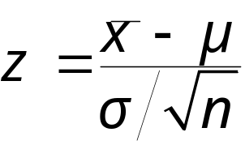
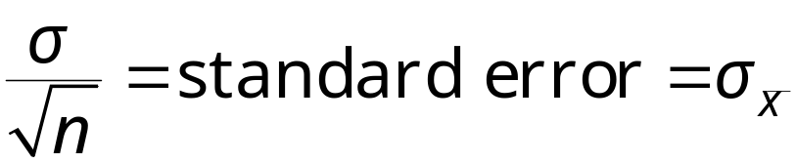
Using P-values for a z-Test
The z-test for the mean is a statistical test for a population mean. The z-test can be used when the population is normal and σ is known, or for any population when the sample size n is at least 30.
The test statistic is the sample mean and the standardized test statistic is z.
When n ≥ 30, the sample standard deviation s can be substituted for σ.

Slide 27
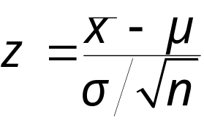
Using P-values for a z-Test
Using P-values for a z-Test for a Mean μ
In Words In Symbols
State the claim mathematically and verbally. Identify the null and alternative hypotheses.
Specify the level of significance.
Determine the standardized test statistic.
Find the area that corresponds to z.
State H₀ and H_{a}.
Identify α.
Use Table 4 in Appendix B.
Continued.

Slide 28
Using P-values for a z-Test
Using P-values for a z-Test for a Mean μ
In Words In Symbols
Find the P-value.
For a left-tailed test, P = (Area in left tail).
For a right-tailed test, P = (Area in right tail).
For a two-tailed test, P = 2(Area in tail of test statistic).
Make a decision to reject or fail to reject the null hypothesis.
Interpret the decision in the context of the original claim.
Reject H₀ if P-value is less than or equal to α. Otherwise, fail to reject H₀.

Slide 29

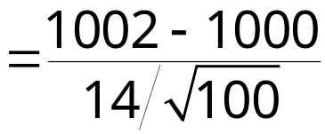

Hypothesis Testing with P-values
Example:
A manufacturer claims that its rechargeable batteries are good for an average of more than 1,000 charges. A random sample of 100 batteries has a mean life of 1002 charges and a standard deviation of 14. Is there enough evidence to support this claim at α = 0.01?
H₀: μ ≤ 1000
H_{a}: μ > 1000 (Claim)
The level of significance is α = 0.01.
The standardized test statistic is
Continued.

Slide 30

Hypothesis Testing with P-values
Example continued:
A manufacturer claims that its rechargeable batteries are good for an average of more than 1,000 charges. A random sample of 100 batteries has a mean life of 1002 charges and a standard deviation of 14. Is there enough evidence to support this claim at α = 0.01?
H₀: μ ≤ 1000
H_{a}: μ > 1000 (Claim)
The area to the right of z = 1.43 is P = 0.0764.
P-value is greater than α = 0.01, fail to reject H₀.
1.43
z
0
At the 1% level of significance, there is not enough evidence to support the claim that the rechargeable battery has an average life of at least 1000 charges.

Slide 31
Rejection Regions and Critical Values
A rejection region (or critical region) of the sampling distribution is the range of values for which the null hypothesis is not probable. If a test statistic falls in this region, the null hypothesis is rejected. A critical value z₀ separates the rejection region from the nonrejection region.
Example:
Find the critical value and rejection region for a right tailed test with α = 0.01.
α = 0.01
The rejection region is to the right of z₀ = 2.575.
2.575
z
0

Slide 32

Rejection Regions and Critical Values
Finding Critical Values in a Normal Distribution
Specify the level of significance α.
Decide whether the test is left-, right-, or two-tailed.
Find the critical value(s) z₀. If the hypothesis test is
  left-tailed, find the z-score that corresponds to an area of α,
  right-tailed, find the z-score that corresponds to an area of 1 – α,
  two-tailed, find the z-score that corresponds to α and 1 – α.
  Sketch the standard normal distribution. Draw a vertical line at each critical value and shade the rejection region(s).

Slide 33
Rejection Regions for a z-Test
Decision Rule Based on Rejection Region
To use a rejection region to conduct a hypothesis test, calculate the standardized test statistic, z. If the standardized test statistic
is in the rejection region, then reject H₀.
is not in the rejection region, then fail to reject H₀.
Fail to reject H_{o.}
Fail to reject H_{o.}
Reject H_{o.}
Reject H_{o.}
z
z
z < z₀
z₀
z₀
z > z₀
0
Fail to reject H_{o.}
0
Left-Tailed Test
Right-Tailed Test
Reject H_{o.}
Reject H_{o.}
z
z < z₀
−z₀
0
z₀
z > z₀
Two-Tailed Test

Slide 34
Rejection Regions for a z-Test
Using Rejection Regions for a z-Test for a Mean μ
In Words In Symbols
State the claim mathematically and verbally. Identify the null and alternative hypotheses.
Specify the level of significance.
Sketch the sampling distribution.
Determine the critical value(s).
Determine the rejection regions(s).
State H₀ and H_{a}.
Identify α.
Use Table 4 in Appendix B.
Continued.

Slide 35
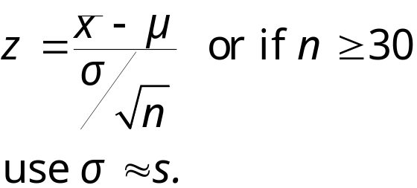
Rejection Regions for a z-Test
Using Rejection Regions for a z-Test for a Mean μ
In Words In Symbols
Find the standardized test statistic.
Make a decision to reject or fail to reject the null hypothesis.
Interpret the decision in the context of the original claim.
If z is in the rejection region, reject H₀. Otherwise, fail to reject H₀.

Slide 36
Testing with Rejection Regions
Example:
A local telephone company claims that the average length of a phone call is 8 minutes. In a random sample of 58 phone calls, the sample mean was 7.8 minutes and the standard deviation was 0.5 minutes. Is there enough evidence to support this claim at α = 0.05?
H₀: μ = 8 (Claim)
H_{a}: μ ≠ 8
The level of significance is α = 0.05.
0.025
0.025
z
−z₀ = −1.96
0
z₀ = 1.96
Continued.

Slide 37
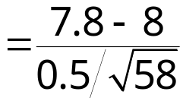

Testing with Rejection Regions
Example continued:
A local telephone company claims that the average length of a phone call is 8 minutes. In a random sample of 58 phone calls, the sample mean was 7.8 minutes and the standard deviation was 0.5 minutes. Is there enough evidence to support this claim at α = 0.05?
H₀: μ = 8 (Claim)
H_{a}: μ ≠ 8
The standardized test statistic is
The test statistic falls in the rejection region, so H₀ is rejected.
z
−z₀ = −1.96
0
z₀ = 1.96
At the 5% level of significance, there is enough evidence to reject the claim that the average length of a phone call is 8 minutes.

Slide 38
§ 7.3
Hypothesis Testing for the Mean (Small Samples)

Slide 39
Critical Values in a t-Distribution
Finding Critical Values in a t-Distribution
Identify the level of significance α.
Identify the degrees of freedom d.f. = n – 1.
Find the critical value(s) using Table 5 in Appendix B in the row with n – 1 degrees of freedom. If the hypothesis test is
  left-tailed, use “One Tail, α ” column with a negative sign,
  right-tailed, use “One Tail, α ” column with a positive sign,
  two-tailed, use “Two Tails, α ” column with a negative and a positive sign.

Slide 40
Finding Critical Values for t
Example:
Find the critical value t₀ for a right-tailed test given α = 0.01 and n = 24.
The degrees of freedom are d.f. = n – 1 = 24 – 1 = 23.
To find the critical value, use Table 5 with d.f. = 23 and 0.01 in the “One Tail, α “ column. Because the test is a right-tail test, the critical value is positive.
t₀ = 2.500

Slide 41
Finding Critical Values for t
Example:
Find the critical values t₀ and −t₀ for a two-tailed test given α = 0.10 and n = 12.
The degrees of freedom are d.f. = n – 1 = 12 – 1 = 11.
To find the critical value, use Table 5 with d.f. = 11 and 0.10 in the “Two Tail, α “ column. Because the test is a two-tail test, one critical value is negative and one is positive.
−t₀ = − 1.796 and t₀ = 1.796

Slide 42
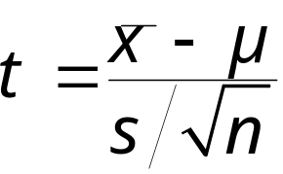
t-Test for a Mean μ (n < 30, σ Unknown)
The t-test for the mean is a statistical test for a population mean. The t-test can be used when the population is normal or nearly normal, σ is unknown, and n < 30.
The test statistic is the sample mean and the standardized test statistic is t.
The degrees of freedom are d.f. = n – 1 .

Slide 43
t-Test for a Mean μ (n < 30, σ Unknown)
Using the t-Test for a Mean μ (Small Sample)
In Words In Symbols
State the claim mathematically and verbally. Identify the null and alternative hypotheses.
Specify the level of significance.
Identify the degrees of freedom and sketch the sampling distribution.
Determine any critical values.
Determine any rejection region(s).
State H₀ and H_{a}.
Identify α.
d.f. = n – 1.
Use Table 5 in Appendix B.
Continued.

Slide 44
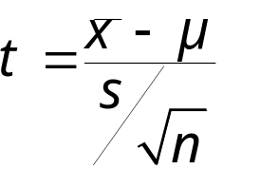
t-Test for a Mean μ (n < 30, σ Unknown)
Using the t-Test for a Mean μ (Small Sample)
In Words In Symbols
Find the standardized test statistic.
Make a decision to reject or fail to reject the null hypothesis.
Interpret the decision in the context of the original claim.
If t is in the rejection region, reject H₀. Otherwise, fail to reject H₀.

Slide 45
Testing μ Using Critical Values
Example:
A local telephone company claims that the average length of a phone call is 8 minutes. In a random sample of 18 phone calls, the sample mean was 7.8 minutes and the standard deviation was 0.5 minutes. Is there enough evidence to support this claim at α = 0.05?
H₀: μ = 8 (Claim)
H_{a}: μ ≠ 8
The level of significance is α = 0.05.
The test is a two-tailed test.
Degrees of freedom are d.f. = 18 – 1 = 17.
The critical values are −t₀ = −2.110 and t₀ = 2.110
Continued.

Slide 46
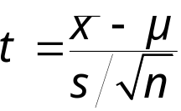
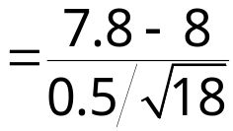

Testing μ Using Critical Values
Example continued:
A local telephone company claims that the average length of a phone call is 8 minutes. In a random sample of 18 phone calls, the sample mean was 7.8 minutes and the standard deviation was 0.5 minutes. Is there enough evidence to support this claim at α = 0.05?
H₀: μ = 8 (Claim)
H_{a}: μ ≠ 8
The standardized test statistic is
The test statistic falls in the nonrejection region, so H₀ is not rejected.
z
−z₀ = −2.110
0
z₀ = 2.110
At the 5% level of significance, there is not enough evidence to reject the claim that the average length of a phone call is 8 minutes.

Slide 47

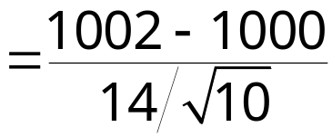

Testing μ Using P-values
Example:
A manufacturer claims that its rechargeable batteries have an average life greater than 1,000 charges. A random sample of 10 batteries has a mean life of 1002 charges and a standard deviation of 14. Is there enough evidence to support this claim at α = 0.01?
H₀: μ ≤ 1000
H_{a}: μ > 1000 (Claim)
The level of significance is α = 0.01.
The degrees of freedom are d.f. = n – 1 = 10 – 1 = 9.
The standardized test statistic is
Continued.

Slide 48

Testing μ Using P-values
Example continued:
A manufacturer claims that its rechargeable batteries have an average life greater than 1,000 charges. A random sample of 10 batteries has a mean life of 1002 charges and a standard deviation of 14. Is there enough evidence to support this claim at α = 0.01?
H₀: μ ≤ 1000
H_{a}: μ > 1000 (Claim)
Using the d.f. = 9 row from Table 5, you can determine that P is greater than α = 0.25 and is therefore also greater than the 0.01 significance level. H₀ would fail to be rejected.
0.45
z
0
At the 1% level of significance, there is not enough evidence to support the claim that the rechargeable battery has an average life of at least 1000 charges.

Slide 49
§ 7.4
Hypothesis Testing for Proportions

Slide 50

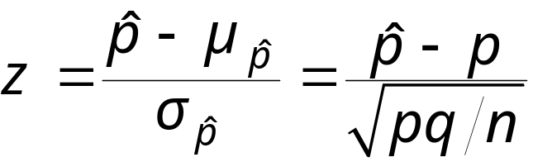
z-Test for a Population Proportion
The z-test for a population is a statistical test for a population proportion. The z-test can be used when a binomial distribution is given such that np ≥ 5 and nq ≥ 5.
The test statistic is the sample proportion and the standardized test statistic is z.

Slide 51
Hypothesis Test for Proportions
Using a z-Test for a Proportion p
Verify that np ≥ 5 and nq ≥ 5.
In Words In Symbols
State the claim mathematically and verbally. Identify the null and alternative hypotheses.
Specify the level of significance.
Sketch the sampling distribution.
Determine any critical values.
State H₀ and H_{a}.
Identify α.
Use Table 4 in Appendix B.
Continued.

Slide 52
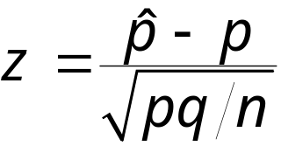
Hypothesis Test for Proportions
Using a z-Test for a Proportion p
Verify that np ≥ 5 and nq ≥ 5.
In Words In Symbols
Determine any rejection regions.
Find the standardized test statistic.
Make a decision to reject or fail to reject the null hypothesis.
Interpret the decision in the context of the original claim.
If z is in the rejection region, reject H₀. Otherwise, fail to reject H₀.

Slide 53
Hypothesis Test for Proportions
Example:
Statesville college claims that more than 94% of their graduates find employment within six months of graduation. In a sample of 500 randomly selected graduates, 475 of them were employed. Is there enough evidence to support the college’s claim at a 1% level of significance?
Verify that the products np and nq are at least 5.
np = (500)(0.94) = 470 and nq = (500)(0.06) = 30
H₀: p ≤ 0.94
H_{a}: p > 0.94 (Claim)
Continued.

Slide 54
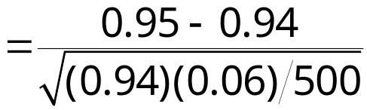

Hypothesis Test for Proportions
Example continued:
Statesville college claims that more than 94% of their graduates find employment within six months of graduation. In a sample of 500 randomly selected graduates, 475 of them were employed. Is there enough evidence to support the college’s claim at a 1% level of significance?
H₀: p ≤ 0.94
H_{a}: p > 0.94 (Claim)
Because the test is a right-tailed test and α = 0.01, the critical value is 2.33.
Test statistic
2.33
z
0
Continued.

Slide 55

Hypothesis Test for Proportions
Example continued:
Statesville college claims that more than 94% of their graduates find employment within six months of graduation. In a sample of 500 randomly selected graduates, 475 of them were employed. Is there enough evidence to support the college’s claim at a 1% level of significance?
H₀: p ≤ 0.94
H_{a}: p > 0.94 (Claim)
The test statistic falls in the nonrejection region, so H₀ is not rejected.
2.33
z
0
At the 1% level of significance, there is not enough evidence to support the college’s claim.

Slide 56
Hypothesis Test for Proportions
Example:
A cigarette manufacturer claims that one-eighth of the US adult population smokes cigarettes. In a random sample of 100 adults, 5 are cigarette smokers. Test the manufacturer's claim at α = 0.05.
Verify that the products np and nq are at least 5.
np = (100)(0.125) = 12.5 and nq = (100)(0.875) = 87.5
H₀: p = 0.125 (Claim)
H_{a}: p ≠ 0.125
Because the test is a two-tailed test and α = 0.05, the critical values are ± 1.96.
Continued.

Slide 57

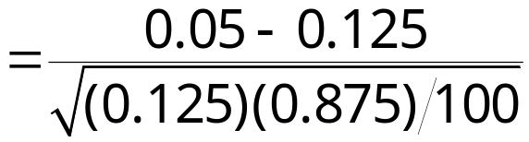

Hypothesis Test for Proportions
Example continued:
A cigarette manufacturer claims that one-eighth of the US adult population smokes cigarettes. In a random sample of 100 adults, 5 are cigarettes smokers. Test the manufacturer's claim at α = 0.05.
H₀: p = 0.125 (Claim)
H_{a}: p ≠ 0.125
The test statistic is
−2.27
z
−z₀ = −1.96
0
z₀ = 1.96
Reject H₀.
At the 5% level of significance, there is enough evidence to reject the claim that one-eighth of the population smokes.

Slide 58
§ 7.5
Hypothesis Testing for Variance and Standard Deviation

Slide 59
Critical Values for the χ²-Test
Finding Critical Values for the χ²⁻Distribution
Specify the level of significance α.
Determine the degrees of freedom d.f. = n – 1.
The critical values for the χ²-distribution are found in Table 6 of Appendix B. To find the critical value(s) for a
  right-tailed test, use the value that corresponds to d.f. and α.
  left-tailed test, use the value that corresponds to d.f. and 1 – α.
  two-tailed test, use the values that corresponds to d.f. and α and d.f. and 1 – α.

Slide 60
Finding Critical Values for the χ²
Example:
Find the critical value for a left-tailed test when n = 19 and α = 0.05.
There are 18 d.f. The area to the right of the critical value is 1 – α = 1 – 0.05 = 0.95.
From Table 6, the critical value is χ²₀ = 9.390.
Example:
Find the critical value for a two-tailed test when n = 26 and α = 0.01.
There are 25 d.f. The areas to the right of the critical values are α = 0.005 and 1 – α = 0.995.
From Table 6, the critical values are χ²_{L} = 10.520 and χ²_{R} = 46.928.

Slide 61
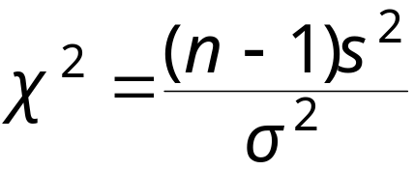
The Chi-Square Test
The χ²-test for a variance or standard deviation is a statistical test for a population variance or standard deviation. The χ²-test can be used when the population is normal.
The test statistic is s² and the standardized test statistic
follows a chi-square distribution with degrees of freedom d.f. = n – 1.

Slide 62
The Chi-Square Test
Using the χ²-Test for a Variance or Standard Deviation
In Words In Symbols
State the claim mathematically and verbally. Identify the null and alternative hypotheses.
Specify the level of significance.
Determine the degrees of freedom and sketch the sampling distribution.
Determine any critical values.
State H₀ and H_{a}.
Identify α.
d.f. = n – 1
Use Table 6 in Appendix B.
Continued.

Slide 63
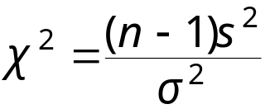
The Chi-Square Test
Using the χ2-Test for a Variance or Standard Deviation
In Words In Symbols
Determine any rejection regions.
Find the standardized test statistic.
Make a decision to reject or fail to reject the null hypothesis.
Interpret the decision in the context of the original claim.
If χ² is in the rejection region, reject H₀. Otherwise, fail to reject H₀.

Slide 64

Hypothesis Test for Standard Deviation
Example:
A college professor claims that the standard deviation for students taking a statistics test is less than 30. 10 tests are randomly selected and the standard deviation is found to be 28.8. Test this professor’s claim at the α = 0.01 level.
H₀: σ ≥ 30
H_{a}: σ < 30 (Claim)
This is a left-tailed test with d.f.= 9 and α = 0.01.
X²
Continued.

Slide 65
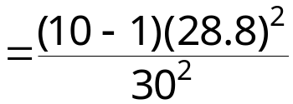

Hypothesis Test for Standard Deviation
Example continued:
A college professor claims that the standard deviation for students taking a statistics test is less than 30. 10 tests are randomly selected and the standard deviation is found to be 28.8. Test this professor’s claim at the α = 0.01 level.
H₀: σ ≥ 30
H_{a}: σ < 30 (Claim)
χ²₀ = 2.088
X²
Fail to reject H₀.
X²₀ = 2.088
At the 1% level of significance, there is not enough evidence to support the professor’s claim.

Slide 66

Hypothesis Test for Variance
Example:
A local balloon company claims that the variance for the time its helium balloons will stay afloat is 5 hours. A disgruntled customer wants to test this claim. She randomly selects 23 customers and finds that the variance of the sample is 4.5 seconds. At α = 0.05, does she have enough evidence to reject the company’s claim?
H₀: σ² = 5 (Claim)
H_{a}: σ² ≠ 5
This is a two-tailed test with d.f.= 22 and α = 0.05.
X²_{L}
X²_{R}
X²
Continued.

Slide 67
Hypothesis Test for Variance
Example continued:
A local balloon company claims that the variance for the time its helium balloons will stay afloat is 5 hours. A disgruntled customer wants to test this claim. She randomly selects 23 customers and finds that the variance of the sample is 4.5 seconds. At α = 0.05, does she have enough evidence to reject the company’s claim?
H₀: σ² = 5 (Claim)
H_{a}: σ² ≠ 5
The critical values are χ²_{L} = 10.982 and χ²_{R} = 36.781.
X²
10.982
36.781
Continued.

Slide 68

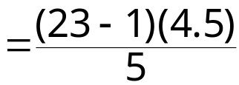

Hypothesis Test for Variance
Example continued:
A local balloon company claims that the variance for the time one of its helium balloons will stay afloat is 5 hours. A disgruntled customer wants to test this claim. She randomly selects 23 customers and finds that the variance of the sample is 4.5 seconds. At α = 0.05, does she have enough evidence to reject the company’s claim?
H₀: σ² = 5 (Claim)
H_{a}: σ² ≠ 5
Fail to reject H₀.
19.8
At α = 0.05, there is not enough evidence to reject the claim that the variance of the float time is 5 hours.
X²
10.982
36.781

